Slide 1
Market Pulse – Social Media & Marketing Campaign Analysis

Slide 2
Marketing Minds
Arsheta
Tripti
Anuradha
Kavita Pal
Kashish Gautam

Slide 3
Workload Division
Contribution of each team member in project
Arsheta -: Developed the dashboard and contributed to visual design.
Kashish Gautam -:Developed the dashboard and prepared the project documentation
Tripti-:Created the PPT and handled video editing
Kavita-:Assisted in PPT preparation and video editing
Anuradha-:Supported documentation and presentation preparation

Slide 4

The Background
Companies struggle to measure
ROI, engagement, CTR, conversions
Across multiple platforms

Slide 5
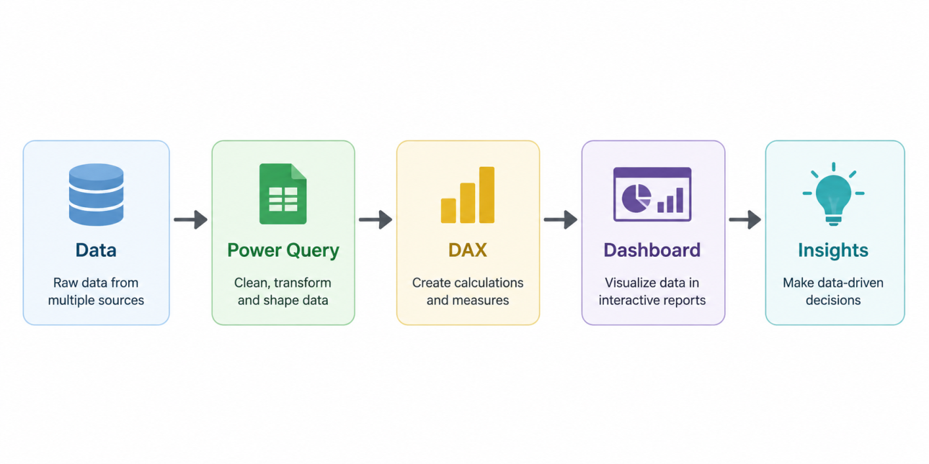
Proposed Solution
ower BI dashboard* integrating campaign data, KPIs, and platform-wise comparisons.
Power BI dashboard integrating campaign data, KPIs, and platform-wise comparisons.

Slide 6
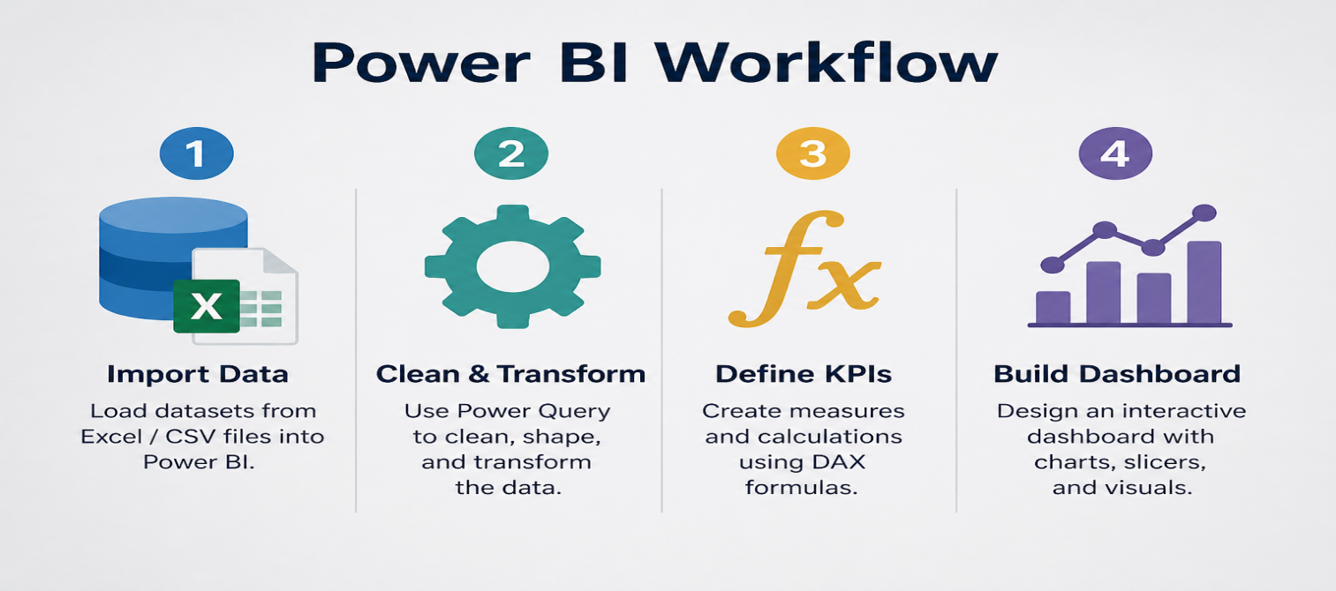
Solution Design
1.Import datasets (Excel/CSV)
2. Clean & transform with Power Query
3. Define KPIs using DAX
4. Build interactive dashboard

Slide 7
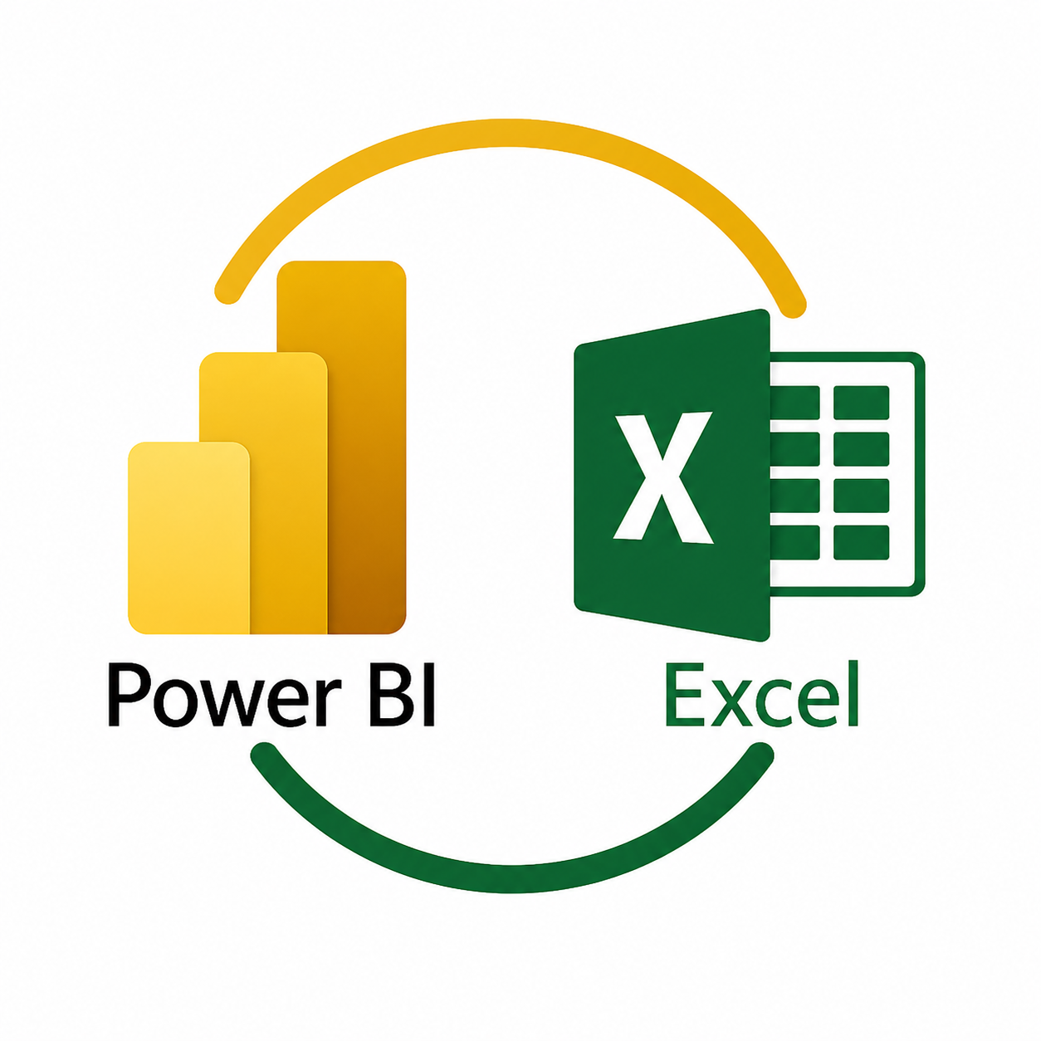
Technology Stack & Requirements
- Microsoft Power BI
- Excel / CSV datasets
- Power Query
- DAX formulas

Slide 8

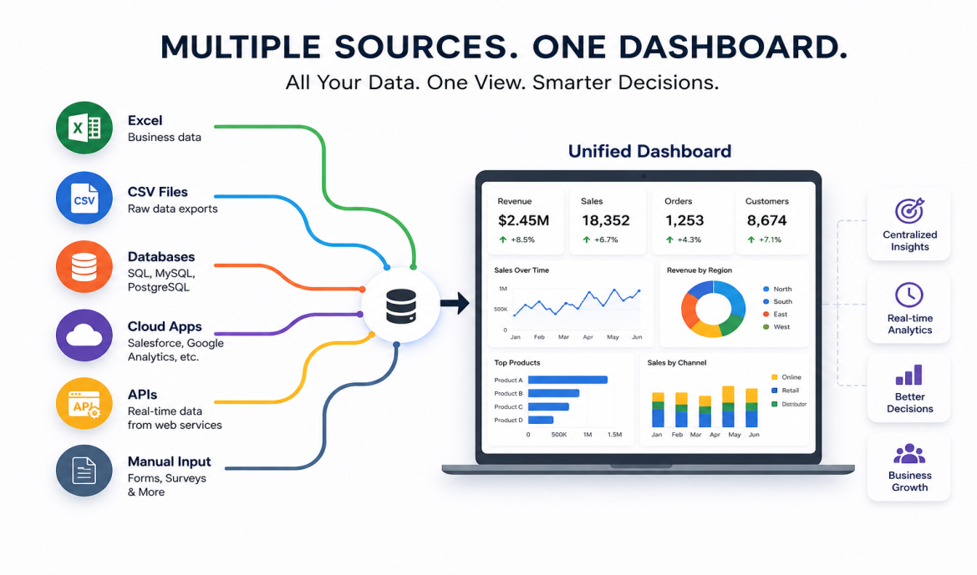
Innovative Idea
Cross-platform insights with real time drill-downs for campaign managers.

Slide 9
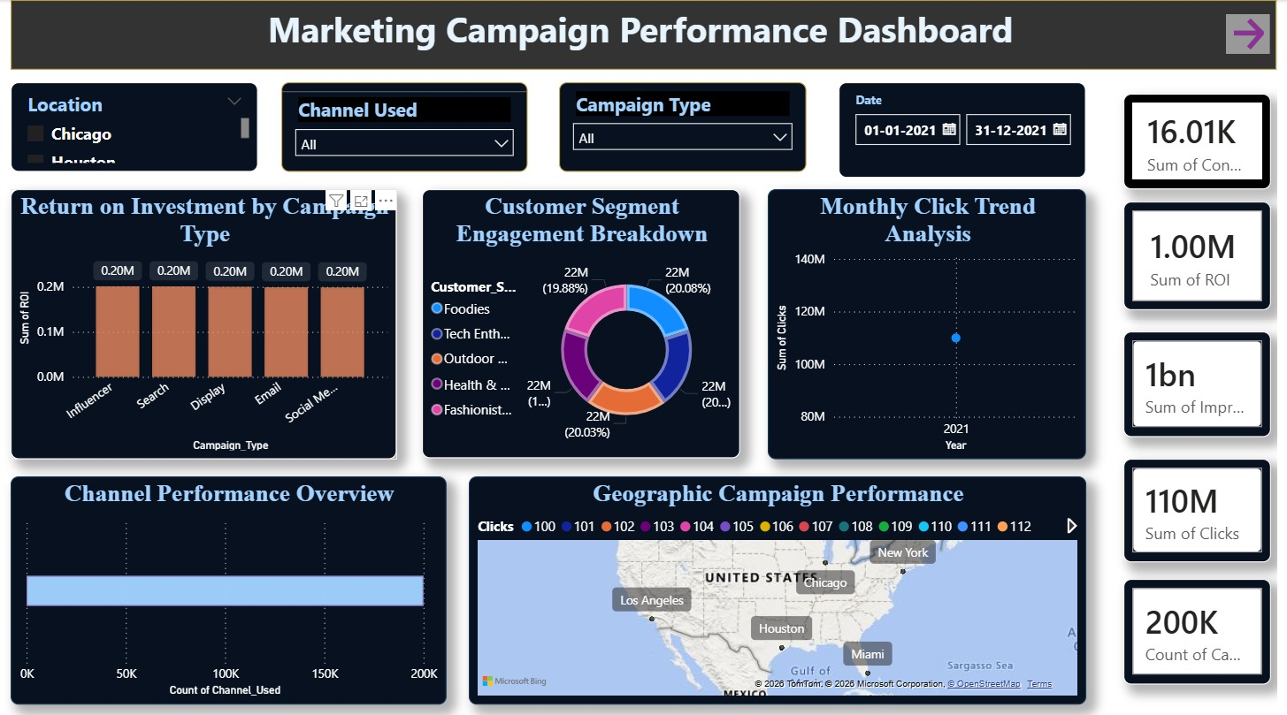
Results / Outcomes / Analysis
- Clicks Achieved vs Target → 220M vs 110M target (2× performance).
- Conversion Rate Trends → Influencer/Search ↑, Display/Email ↓.
- Customer Segments→ Foodies (22.1M), Tech Enthusiasts (22.0M), etc.
- Geo Analysis → Strongest in North America (Chicago, NY, LA).
- Campaign Contribution → Balanced (~20% each).
- Click Trend → Growth from 0.8B (2021) → 1.4B clicks.

Slide 10


Limitations
- Data limited to digital campaigns only.
- ROI aggregated, not campaign-specific.
- Geographic analysis broad.
- Dependent on CSV/Excel data quality.

Slide 11


Future Enhancements/Scope
- Integrate Google Ads & Analytics.
- Predictive modeling for campaign success.
- Real-time alerts for underperforming campaigns.
- Sentiment analysis from social media.

Slide 12
(GITHUB LINK) https://github.com/ArshuSaxena/MarketPulse-Social-Media-Marketing-Campaign-Analysis

Slide 13
Thank You

